Slide 1
Nowruz Celebration
Spring 1401

Slide 2
Nowruz is the first day of Iranian new year, which is the first day of Spring usually on March 20th.
Nowruz means new day

Slide 3
Iran and 12 more Countries have Nowruz as a public holiday

Slide 4
At the moment of transition to the new year, families gather around what its called the “Haft Sin Table”

Slide 5
Haft Seen means Seven S’s It contains several elements symbolizing different aspects of NATURE.

Slide 6
Sabzeh (Wheat Sprouts) : Growth/ Rebirth

Slide 7
Sib (Apple): Health/ Love

Slide 8
Somaq (Sumac): Taste of life/ Sunrise

Slide 9
Sir (Garlic): Medicine/ Health

Slide 10
Senjed (Dried Oleaser Fruit): Love

Slide 11
Serkeh (Vinegar): Old Age and Patience

Slide 12
Samanu (Wheat Sweet Pudding): Affluence

Slide 13
Sekkeh (Coins): Wealth

Slide 14
Mirror: Honesty/ Sky

Slide 15
Gold Fish: Life/ Mobility

Slide 16
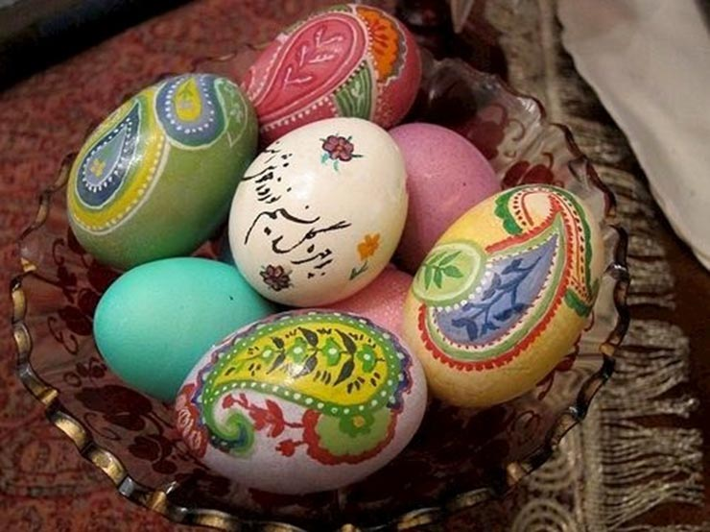
Painted Eggs: Fertility

Slide 17
Candles: Fire/ Light

Slide 18
13 Bedar
13 Bedar means going out on the 13th day of the beginning of the year.
It represents the end of Nowruz celebration.
HAPPY NOWRUZ

